Slide 1



Team 1.05
May 16, 2021
Team New Futures
Notes:
Feedback
Emphasize the story: frustration, time spent looking for appointments
Used what’s out there but it’s not working
Need an attractive name for the site
Concern re: timeframe, things changing all the time
Solution should be adaptable to other vaccines, etc.
Will it be applicable/relevant to something else?
Scalability
Clearly defined the market
Change the narrative for it: reframe it to not just a COVID thing
COVID raised awareness for this lack of centralized system
See if this problem has existed before
Problem, sol’n, competition, stats, meet the team
Extra slide with answers
Backend
Business model

Slide 2

The Problem
Team 1.05
‹#›
Notes:
I am
an 18-49 year old Ontarian
I’m trying to
book a COVID-19 vaccine appointment,
but
I don’t know where and/or how to book an appointment
because
the websites are to complicated and I have to search multiple websites multiple times,
which makes me feel
frustrated.

Slide 3
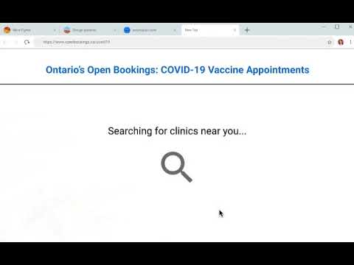
Our Solution: Open Bookings
Team 1.05
Notes:
Open Bookings only show available appointments

Slide 4
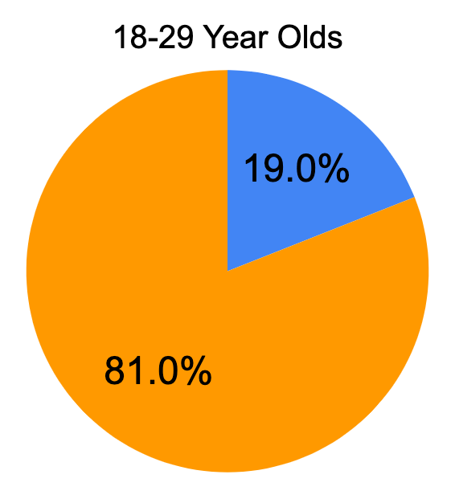
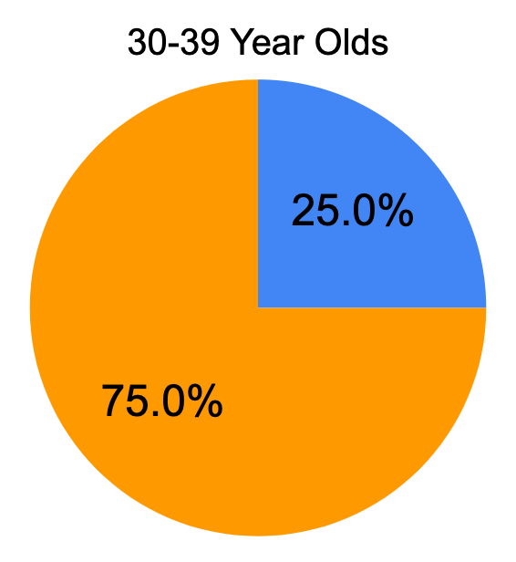
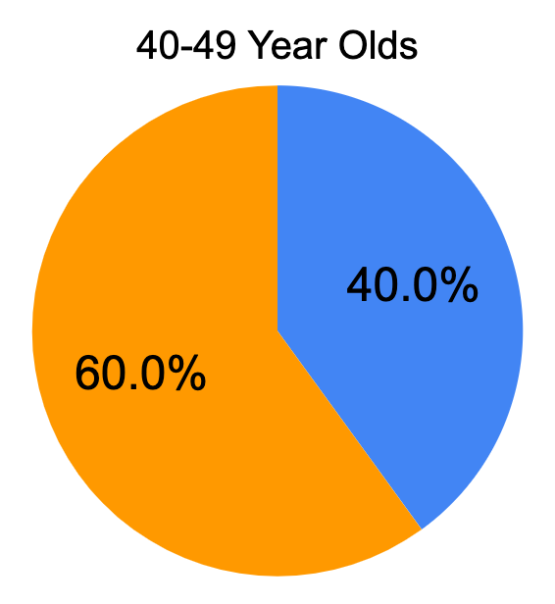
As of May 8, 2021...
Team 1.05
Unvaccinated
>60% of 18-49 year olds have not yet been vaccinated
‹#›
Notes:
It’s estimated that < 40% of 18-40 year olds in Ontario have received at least 1 vaccine dose
< 40% of 18-49 year olds in Ontario have received at least 1 vaccine dose.

Slide 5
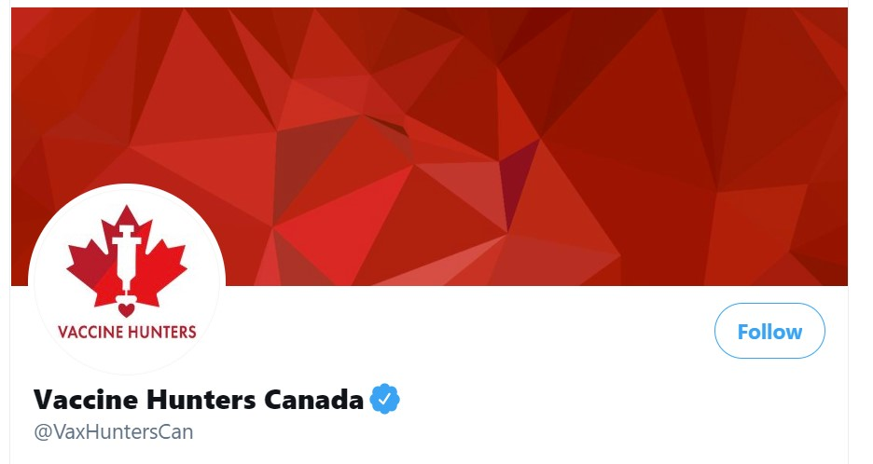

Currently Available Solutions
Team 1.05
Text your postal code to
+1 (833) 356-1683
A Twitter account
Need to navigate multiple websites
Doesn’t show what’s in your area
Crowdsourced
Shows nearby sites
Doesn’t show open bookings
‹#›

Slide 6


Beyond COVID-19
Team 1.05
Additional vaccines such as
influenza and shingles
Find open bookings for doctors, physiotherapists, dentists, government agencies, nail salons, etc...
Notes:
Other countries that still have shortage of vaccines
flu season, shingles vaccines, covid booster?,
Finding available appointments for doctors office, dentist, government agencies

Slide 7

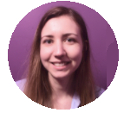
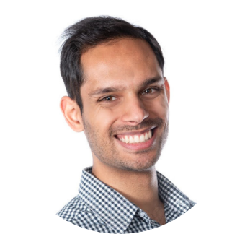
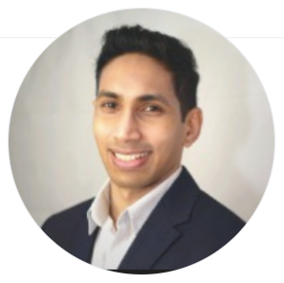
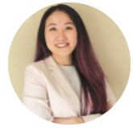
Meet The Team
Team 1.05
Joanna Getek
Registered Nurse
joannagetek@gmail.com
LinkedIn: joannagetek
Zayn Khamis
Healthcare Advocate
zaynkhamis@msn.com
LinkedIn: zaynkhamis
Dimuth Kurukula
Developer
dimuthkurukula@gmail.com
GitHub: dkurukula
Joey Lee
Registered Nurse
joeylee668@gmail.com
LinkedIn: joeycylee
Github: joeycylee
‹#›

Slide 8
The Technology
Team 1.05
Aggregates all clinic websites
Collect end-user data to make form requests on clinic sites
Scrapes schedules for availability
Open Bookings displays relevant data

Slide 9
Business Model
Team 1.05
Through the pandemic: Open Bookings will be a free service to the community
Post-pandemic: providers will be charged a fee to be listed on our website, and the product will be free for end-users

